Slide 1

Optimizing Customer Satisfaction: A Deep Dive into Spar Nord Bank ATM Transactions
The Pie Sparkers
Bhavana Prasad, Jay Dale, Rashmi Shree , Sawan Beli

Slide 2

Introduction

Slide 3
Introduction
Spar Nord Bank is a Danish financial institution that aims to improve its ATM management system and customer experience using data analysis.
The project involves using different AWS services to collect and analyze transactional data from the bank's ATMs to identify customer behavior patterns and trends, make suggestions for improving the ATM network, and establish best practices for data governance and privacy.
The project's ultimate goal is to help Spar Nord Bank optimize its services, reduce costs and risks, and provide a better overall experience for its customers by making data-driven decisions based on accurate, consistent, and secure data.

Slide 4

Goals and Objectives

Slide 5
Goals and Objectives
To analyze Spar Nord Bank's ATM transaction data to gain insights into customer behavior and preferences.
To identify patterns and trends in ATM usage, such as peak usage times and popular transaction types.
To explore the relationship between weather conditions and ATM usage, and how this might inform the bank's approach to managing its ATM network.
To develop effective data visualization techniques to communicate the findings of the analysis to key stakeholders within the bank.
To make recommendations for future improvements to the ATM network, based on the insights gained from the analysis.

Slide 6

Problem and Motivation

Slide 7
Problem and Motivation
The Spar Nord Bank has a large ATM network, but there is currently a lack of insights into how customers use the network. This makes it difficult for the bank to optimize its ATM services and improve the customer experience.
With the increasing popularity of mobile banking and other digital services, it is important for the Spar Nord Bank to understand how ATM usage is evolving and how they can keep their ATM network relevant and useful to customers.
By analyzing ATM transaction data, the Spar Nord Bank can gain valuable insights into customer behavior, preferences, and needs.
This can help the bank make data-driven decisions about where to allocate resources and how to improve its ATM services.

Slide 8

Data Overview

Slide 9
Data Overview
The data used in this project is transactional data of Spar Nord Bank's ATM network from Kaggle. The dataset contains over 2.5 million records of ATM transactions conducted by customers of Spar Nord Bank.
The data includes information about the time and location of each transaction, as well as the type of transaction and the card used. Dataset samples were used to provide a glimpse of the actual data and its structure.
These samples were used to get an idea of the data's format, the types of information included, and to help decide which data cleaning techniques to apply.

Slide 10
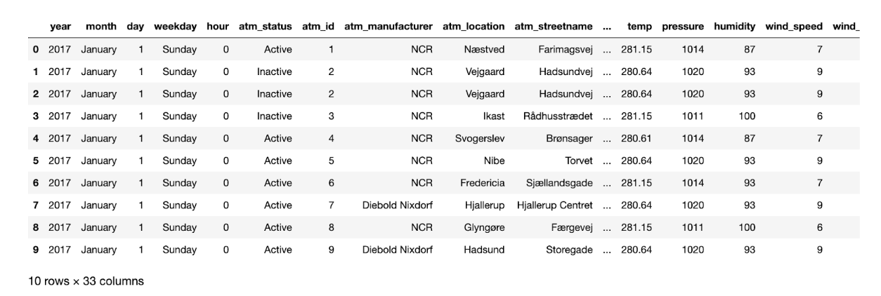
Sample Dataset

Slide 11

Architecture and Project Flow

Slide 12
Architecture and Project Flow
The project architecture consisted of several components such as data engineering, data analytics, and data visualization. The data was initially imported from the RDS using Sqoop and then processed using an ETL pipeline.
The data modeling process involved designing an entity-relationship (ER) diagram to illustrate the relationships between the various data entities in the dataset. This helped to create a clear understanding of the data flow and how different elements were related to one another.
The project flow involved a series of steps, including importing the data, cleaning and transforming the data, storing it in the data warehouse, analyzing the data, and finally, visualizing the data. Each step was carefully designed to ensure that the data was processed accurately and efficiently, and that the end results were reliable and insightful.

Slide 13
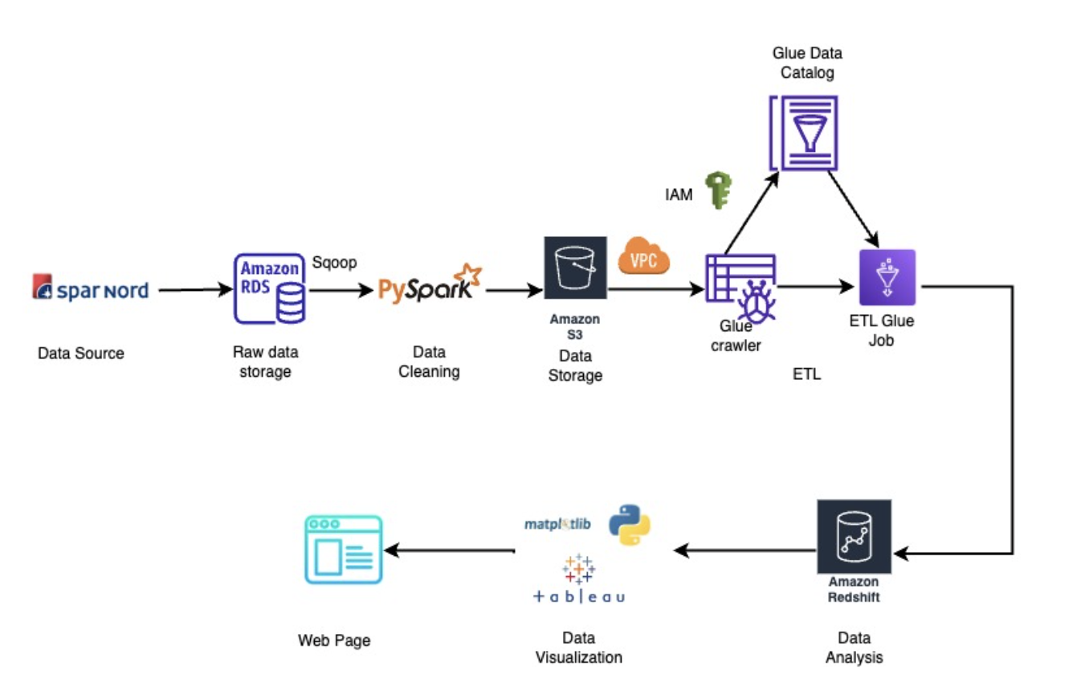

Slide 14
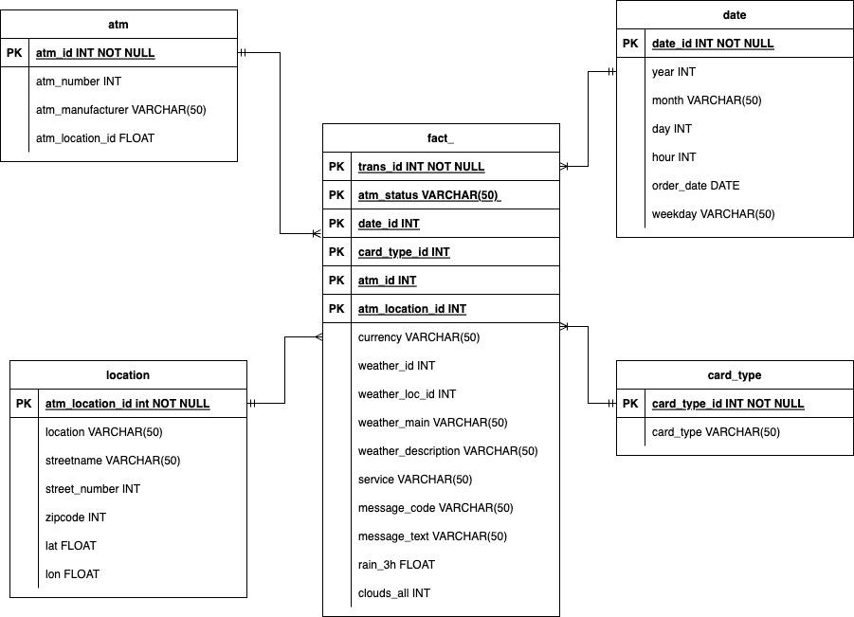
Data Model

Slide 15

Data Engineering

Slide 16
Data Engineering
Importing Data: The Spar Nord bank ATM transactions data is extracted using Sqoop from RDS.
Data Cleaning: We cleaned the data to ensure consistency and accuracy by removing duplicates, handling missing values, and correcting data types using PySpark on Google Colab.
ETL Process: We performed Extract, Transform, Load (ETL) operations to prepare the data for analysis. We extracted the data, transformed it to remove inconsistencies, and loaded it into Redshift Data Warehouse using Glue.

Slide 17
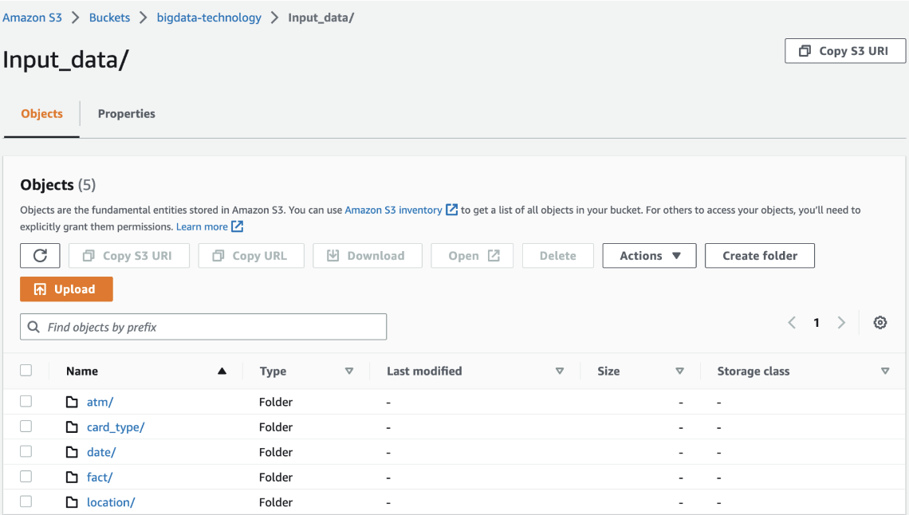
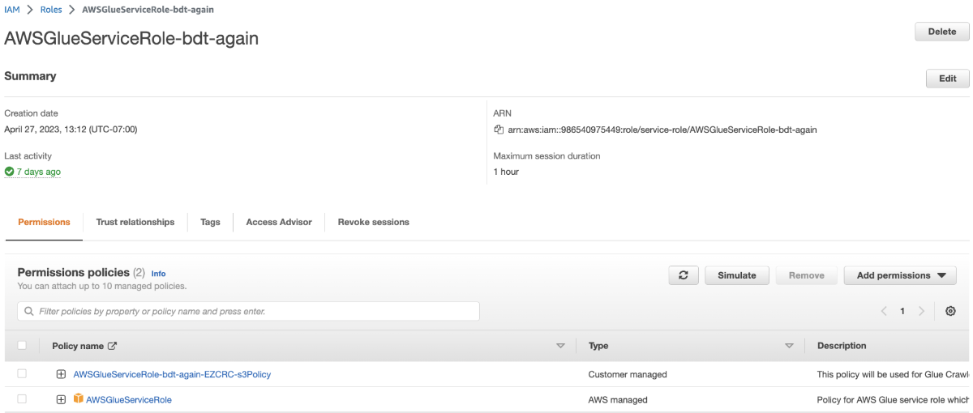
Data Flow using AWS Services
S3 bucket
IAM Role

Slide 18
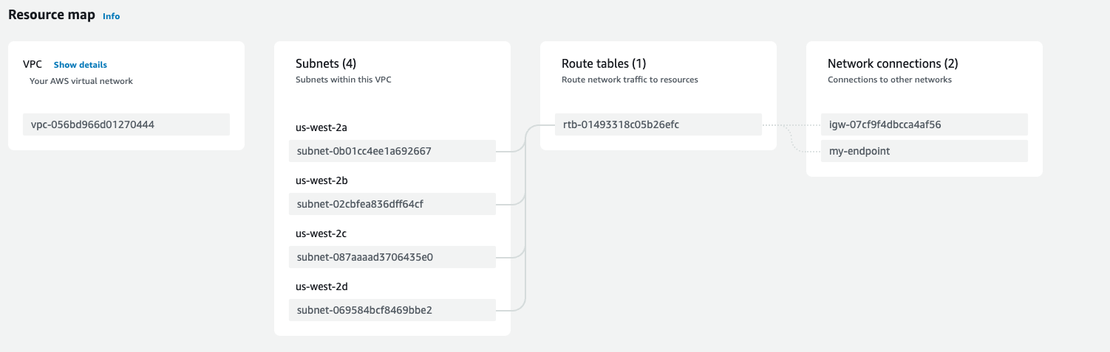
Setting up VPC and Routing table for S3

Slide 19
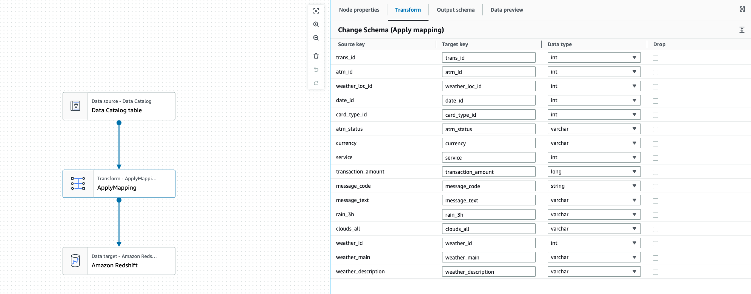
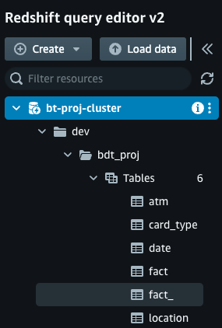
AWS Glue Job

Slide 20

Data Analytics and Visualization

Slide 21
Data Analytics and Visualization
Data analytics was performed using Amazon Redshift, a cloud-based data warehouse that allows for fast querying and processing of large datasets.
Key insights and findings from the data analytics include trends in ATM usage by time of day, day of week, and location, as well as correlations between ATM usage and weather conditions.
Data visualization techniques used in the project include line charts, bar charts which helped to visually communicate the trends and insights discovered through data analysis.

Slide 22
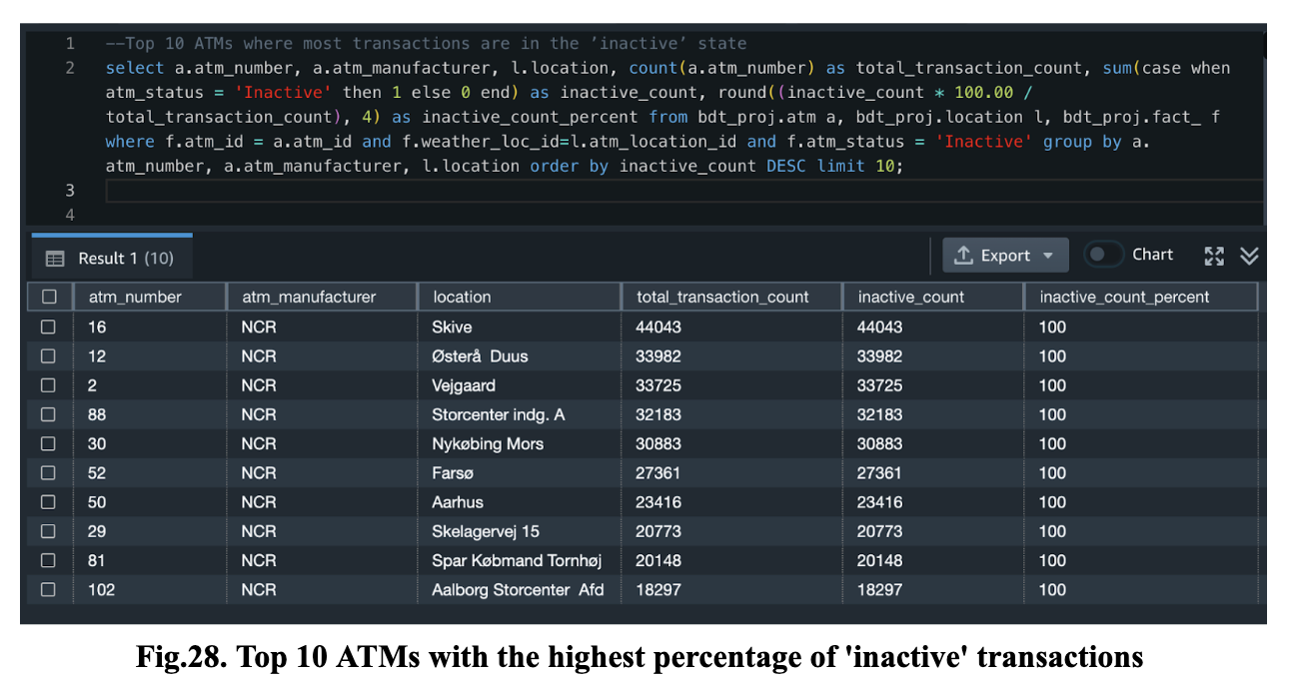
Top 10 ATMs with the highest percentage of 'inactive' transactions

Slide 23
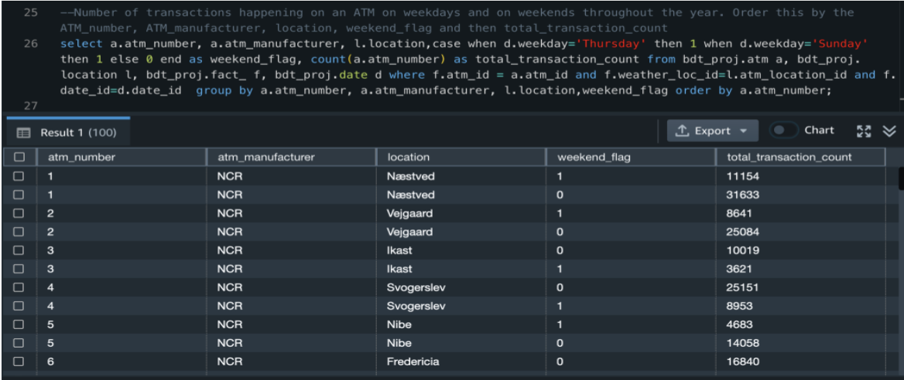
Amount of transactions made annually on weekdays and weekends using an ATM

Slide 24
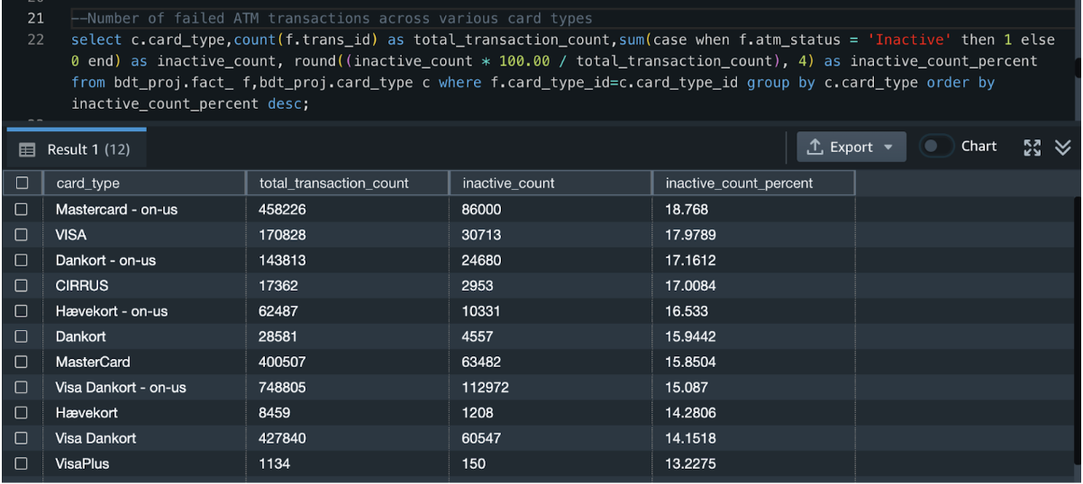
Number of unsuccessful ATM transactions using different card types

Slide 25
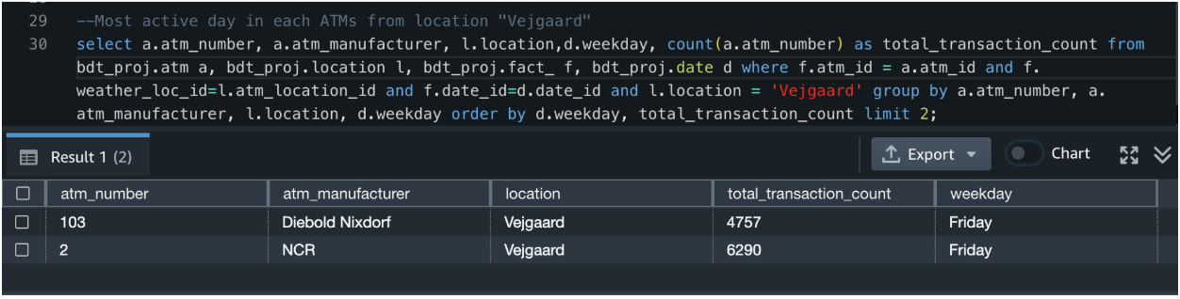
Most active day (in terms of transactions) in each ATM in Vejgaard location

Slide 26
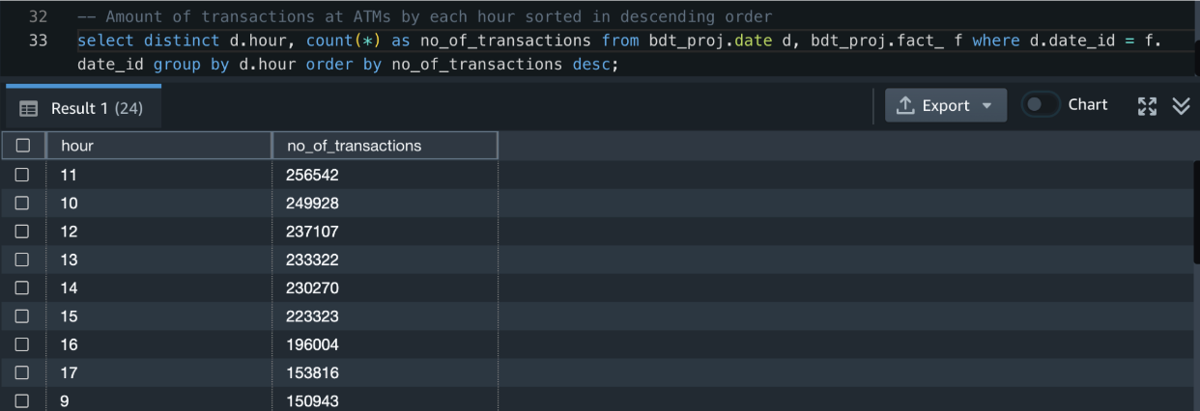
During what time frame most ATM transactions occurred

Slide 27
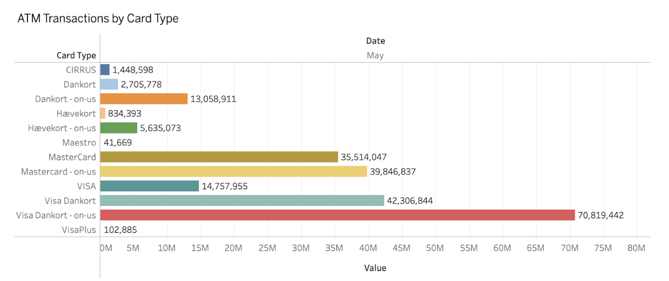

Slide 28
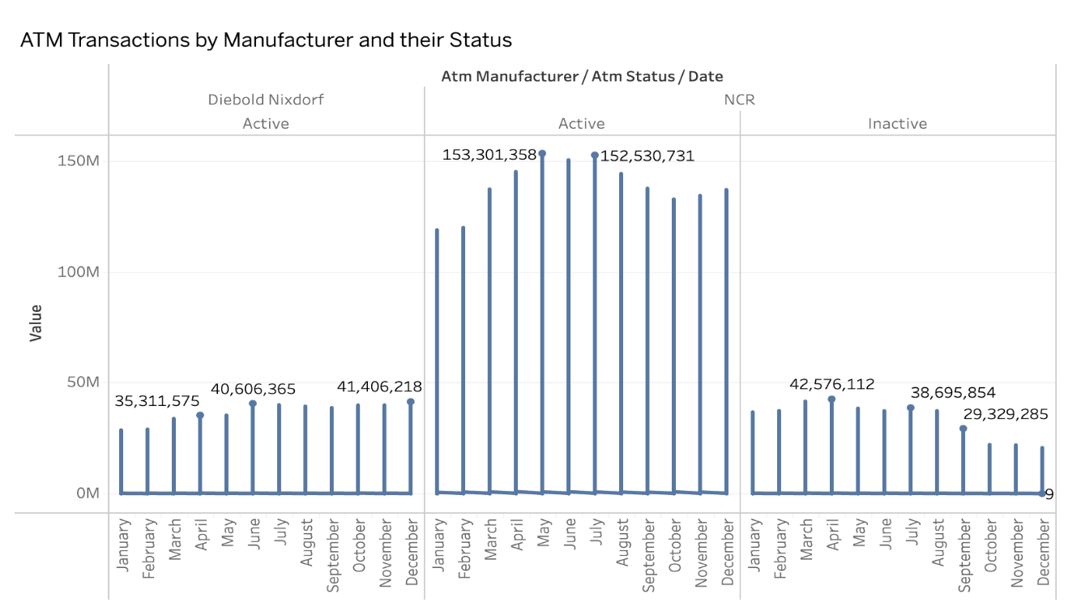

Slide 29
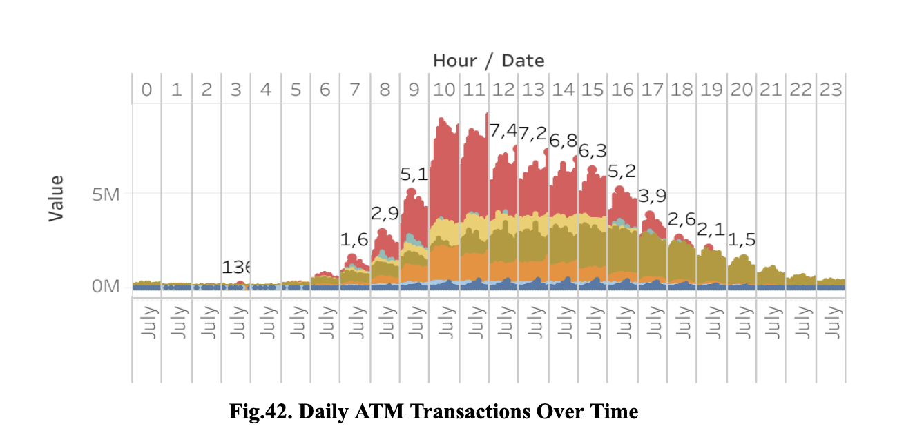

Slide 30
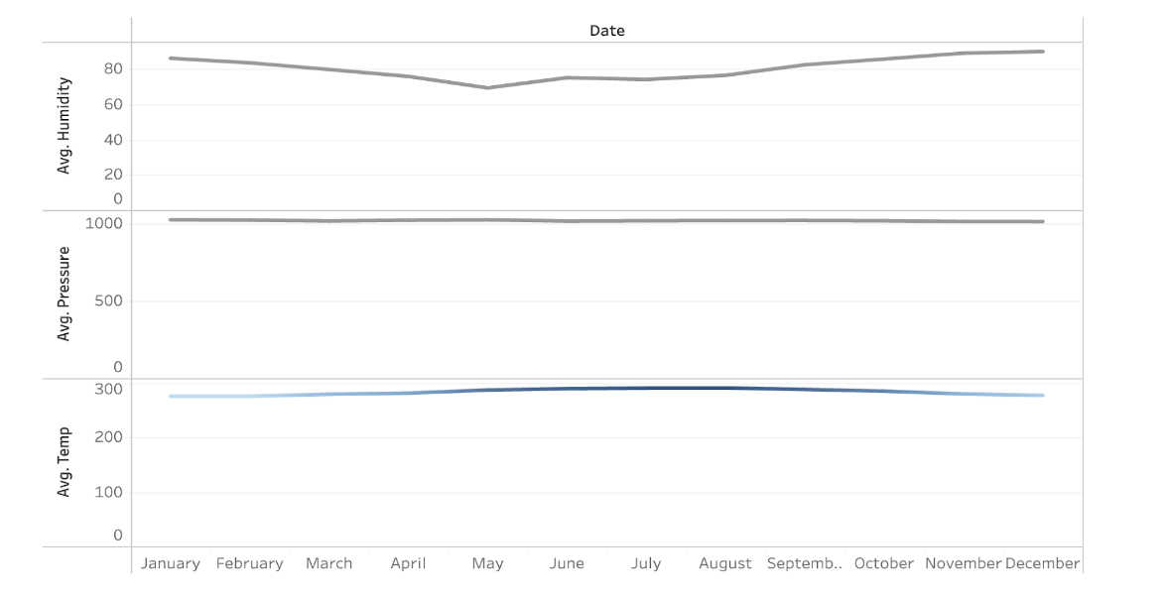

Slide 31

Conclusion

Slide 32
Conclusion
Insights into Customer Behavior: By analyzing Spar Nord Bank's ATM transactional data, our project provided valuable insights into customer behavior, such as peak transaction times and preferred payment methods. These insights can inform the bank's decision-making processes and help optimize the bank's ATM network.
Potential Cost Savings: Our study revealed that the bank can utilize non-peak time periods to refill the ATMs, potentially saving money on the cost of refilling the machines. This finding demonstrates the potential cost savings that can be achieved through data-driven optimization.

Slide 33

Future Work

Slide 34
Future Work
Explore the impact of ATM features on usage: As mentioned in the previous point, it could be beneficial to investigate how specific features of ATMs (such as deposit capabilities or language options) influence customer usage patterns. This could involve conducting surveys or collecting additional data from ATM transactions to gain more insights into customer preferences.
Incorporate demographic data: To better understand the needs and behaviors of different customer segments, future work could involve collecting and analyzing demographic data on ATM users (such as age, gender, income, etc.). This information could be used to inform decisions about where to locate ATMs, what features to offer, and how to market ATM services to different audiences.
Build predictive models: By leveraging the data gathered from ATM transactions, future work could involve building predictive models to forecast usage patterns, detect anomalies, and identify opportunities for optimization. This could involve using machine learning algorithms to identify patterns and trends in the data, and then using these insights to make informed decisions about ATM operations and strategy.

Slide 35
References
https://dribbble.com/shots/3076212-ATM
2.5M Danish ATM Transactions from 2017. (2019, January 16). Kaggle.https://www.kaggle.com/datasets/sparnord/danish-atm-transactions
https://www.sparnord.com/

